Slide 1
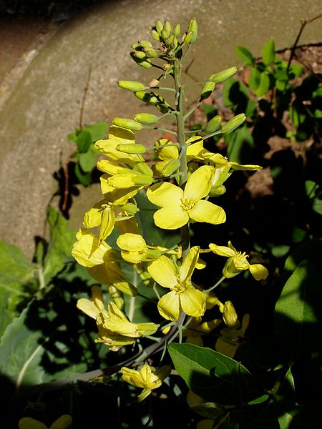
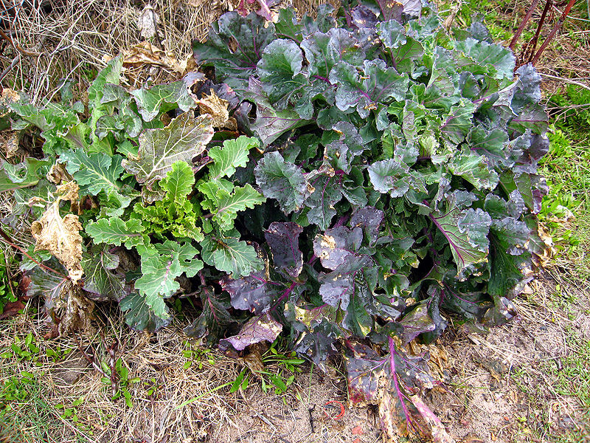
Brassica oleracea
By: Megana Kasavaraju
Block: 4

Slide 2
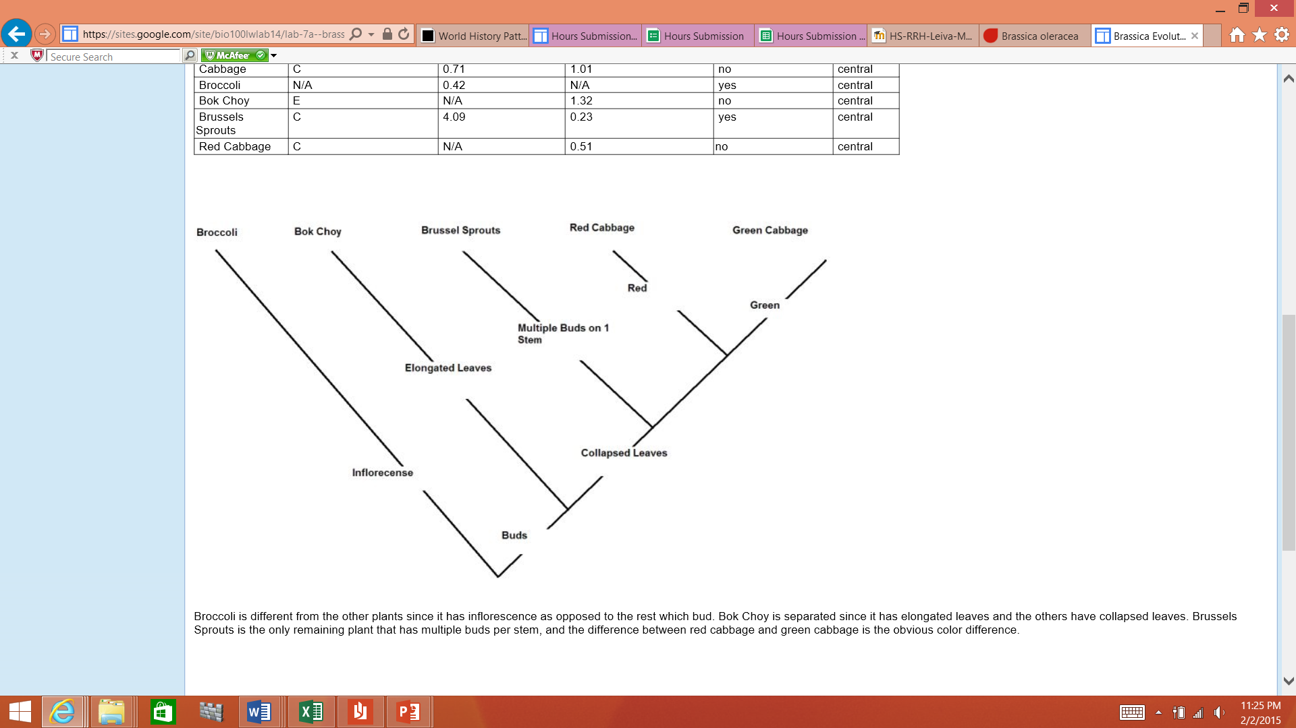
Classification
Kingdom: Plantae
Subkingdom: Tracheobionta
Superdivision: Spermatophyta
Division: Magnoliophyta
Class: Magnoliopsida
Subclass: Dilleniidae
Order: Capparales
Family: Brassicaceae ⁄ Cruciferae
Genus: Brassica
Species: Brassica oleracea
Common Name: Broccoli, Cabbage, Wild Cabbage, Brussel Sprouts, and Cauliflower
Scientific name: Brassica oleracea
Status: Brassica oleracea is assessed as Data Deficient because there is insufficient information available to evaluate this species.
Kingdom | Phylum | Class | Order | Family
PLANTAE | TRACHEOPHYTA | MAGNOLIOPSIDA | CAPPARALES | CRUCIFERAE

Slide 3
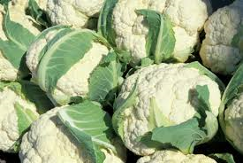
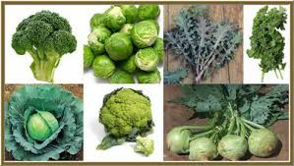
Varieties
There are numerous types of the Brassica oleracea such as broccoli, cabbage, cauliflower, collards, Chinese broccoli, Brussels sprouts, kale, curly kale, and kohlrabi. Their distinguishing characteristics are the types of textures they have and types of buds.
The var. alboglabra type is Chinese broccoli or Chinese kale. It produces fleshy stems and crowded flower buds.
The var. botrytris type is cauliflower and Cape broccoli. They have large fleshy stems and flower buds that do not open.
The var. capitata is cabbage, red cabbage, and Savoy cabbage. They have large, rounded leaves that grow together densely together with a fleshy stem.
The var. gemmifera type is Brussels sprouts. They form numerous large buds, with densely packed leaves to form small heads. These buds can grow to 1 m (3 ft) tall.

Slide 4
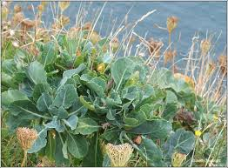
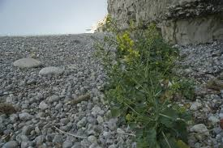
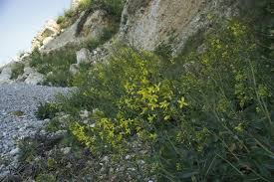
Habitat
The Brassica oleracea is an easily grown plant. It can grow in light (sandy), medium (loamy) and heavy (clay) soils, but it prefers heavy clay soils that are well-drained. It can grow in acid, neutral and basic soils, although it prefers basic. It can grow in semi-shade, no shade, or in full sun.
B. oleracea is native to northern, middle and southwestern Europe where it grows along the coasts of the United Kingdom, Schleswig-Holstein in Germany, the west and north coasts of France and the north coast of Spain.
B. oleracea usually grows in terrestrial environments limestone, chalk cliffs, and below cliffs among shrubs. It sometimes also grows on steep, grassy slopes. It grows in open, rocky places in maritime grassland, inland quarries, waste places, and on roadsides.

Slide 5
Life Cycle
Seed Stage
Dormant seed: There are about 100 seeds per gram
Germinating seed.
Vegetative Stage
1. Young plant (3-5 weeks); hardened plants are frost tolerant and can be among the earliest planted garden vegetables. However, plants that are exposed to low temperature (35 to 45 degrees F) for an extended time can bolt prematurely without producing a firm head.
2. Growth of rosette leaves; at end of this stage B. oleracea forms a firm head. The cabbage heads can be harvested any time when firm head develops.
3. Bud stage; plants reach their maximum leaf area index.
4. Bolting rapid growth of stem
Reproductive Stage
1. Flowering
2. Ripening seeds are mature and attain best germinability and growth vigor in 60 days after flowering
Senescent Stage
Reproduction
The flowers are hermaphrodite because have both male and female organs and are pollinated by Bees. The plant is self-fertile.

Slide 6
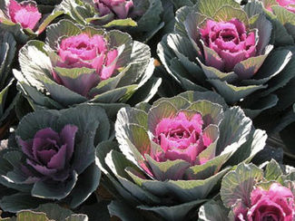
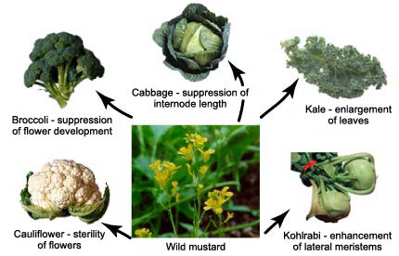
History
The original Brassica oleracea is native to the Mediterranean region of Europe. The wild B. oleracea is believed to have been cultivated for several thousand years, During the Greek and Roman times, it was known to be a well-established garden vegetable.
After the first cultivation of the first Brassica oleracea, cabbage became more popular because their leaves were larger than the plants grown before. The plants with the largest leaves were selected to be grown. Farmers and breeders were using the idea of selection to cause changes in the features of their plants. Farmers and breeders allowed only the plants with desirable characteristics (which was size) to reproduce, causing the evolution of crops. This process is called artificial selection because people (instead of nature) select which organisms get to reproduce.
The continued preference for larger leaves led to kale and other plants. The domestication of the kale and cabbage spread all over Europe. The Brassica oleracea spread from Europe into Mesopotamia and Egypt as a winter vegetable, and later through trade routes though Asia and the Americas.

Slide 7
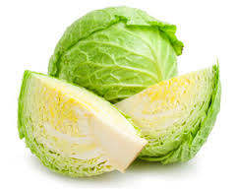
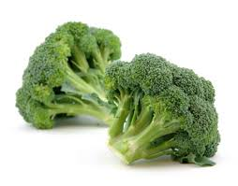
Benefit to Humans
The Brassica oleracea (which includes broccoli, cabbage, red cabbage, Brussel sprout, and cauliflower) provides many sources of nutritious and healthy food for people to eat.
This plant is not only nutritious to eat, it also helps in curing many different illnesses. The leaves are cardiotonic (supports and stimulates the heart) and stomachic (assisting digestion). They have been used in the treatment of gout (a disease that causes arthritis) and rheumatism ( a disease that causes inflammation and pain in the joints, muscles, or fibrous tissue, and rheumatoid arthritis. The leaves can also be used as a poultice (plant used to relieve soreness and inflammation) to cleanse infected.
Brassica vegetables also appear to be especially protective against cancer and heart disease. These vegetables are also known to be beneficial in the prevention of other major illnesses such as Alzheimers, cataracts, and other diseases associated with ageing.
These plants have also been turned into medicine which have antioxidant effects, modulation of detoxification enzymes, stimulation of the immune system, reduction of inflammation, and antibacterial and antiviral effects.

Slide 8
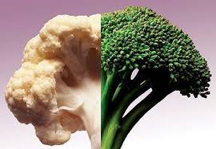
Use in genetics
The Brassica olerace Polyploidization has provided genetic variation for plant evolution, but the way that the evolution of polyploid genomes create the genetic structure of different species are vague. Brassica oleracea is used in this research to increase knowledge of polyploid evolution. This is done by comparing the sequence of Brassica oleracea to its sister species B. rapa. This has revealed numerous chromosome rearrangements, asymmetrical gene loss, and asymmetrical magnification of similar elements. Genes related to the production of anticancer phytochemicals are the consequences of genome duplication and gene difference as shown in this study. This study shows that the Brassica oleracea genome evolution and will lead into research of other types of crops.

Slide 9
Sources Cited
http://faculty.ucc.edu/biology-ombrello/POW/cabbage.htm
http://www.iucnredlist.org/details/170110/0
http://eol.org/pages/583899/overview
http://www.pfaf.org/user/plant.aspx?LatinName=Brassica+oleracea
http://www.nature.org/ncomms/2014/140523/ncomms4930/full/ncomms4930.html
http://evolution.berkeley.edu/evosite/evo101/IIIE4Evochange.shtml
http://www.missouribotanicalgarden.org/PlantFinder/PlantFinderDetails.aspx?kempercode=b738
http://www.itis.gov/servlet/SingleRpt/SingleRpt?search_topic=TSN&search_value=23062
http://californiaagriculture.ucanr.edu/landingpage.cfm?article=ca.v058n02p68&fulltext=yes

